Slide 1

Spirituality:
ITS IMPORTANCE IN HUMAN LIFE
Presented by group 5
Abhirup Kumar Das, Gugoloth Bhuvan Raj, Muskan, Souvik Sarkar, Pranshu Dasgupta
25.01.2023

Slide 2


Topic Outline
INTRODUCTION TO SPIRITUALITY
SPIRITUALITY IN WORK LIFE/ KARMA-YOG
CANCERS OF LIFE
CONCLUSION

Slide 3


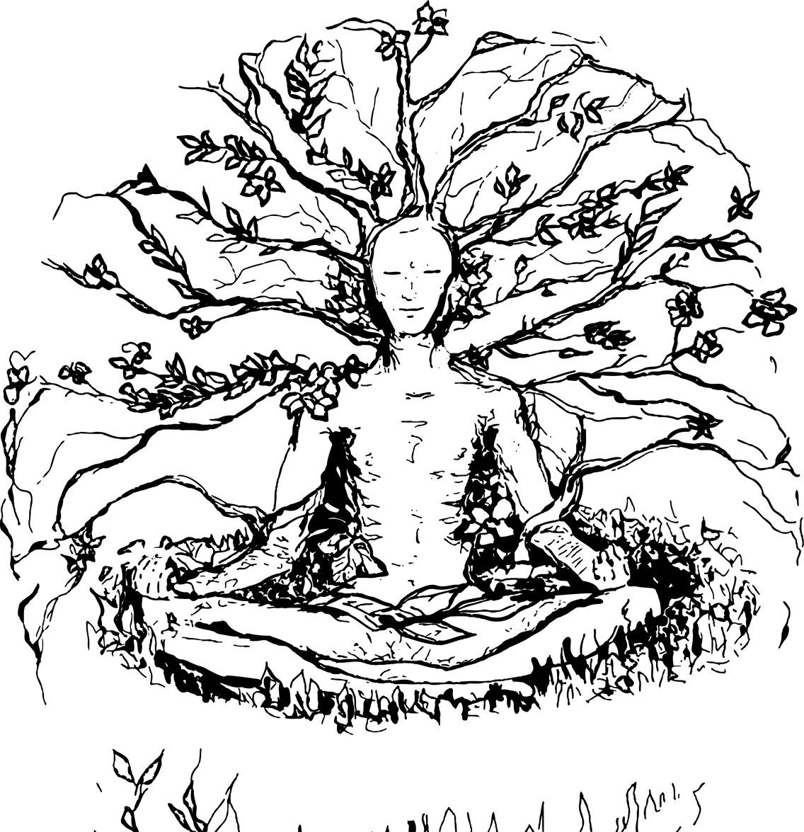

Slide 4


PROBLEMS OF LIFE
People get stuck on negative thoughts
They get lost in a labyrinth

Slide 5




SOLUTIONS OF THE PROBLEMS
Spirituality is the solution.
Every profession solves a problem.
Spirituality focuses on the afterlife and how there is a soul within us.

Slide 6

SOLUTIONS OF THE PROBLEMS
In Bhagavad Gita, Chapter 2, Verse 22, we find that:
vāsānsi jīrṇāni yathā vihāya navāni gṛihṇāti naro ’parāṇi tathā śharīrāṇi vihāya jīrṇānya nyāni sanyāti navāni dehī
-“As a person puts on new garments, giving up old ones, the soul similarly accepts new material bodies, giving up the old and useless ones.”

Slide 7



SOLUTIONS OF THE PROBLEMS
Gita promotes the spirit of detachment, compassion and love.
The whole idea of spirituality is all about helping people.
In the vedic era we had 'mandirs': Hospital for 'maan'/mind.

Slide 8





Slide 9

Karma Yog
In Bhagavad Gita, Chapter 2, Verse 47, we find that:
karmany evadhikaras te ma phalesu kadacana
ma karma-phala-hetur bhur ma te sango 'stv akarmani
-“You have the right to perform your prescribed duty, but you are not entitled to the fruits of action. Never consider yourself the cause of the results of your activities, and never be attached to not doing your duty.”

Slide 10

Karma Yog
Everyone should act without attachment to the result.
Such disinterested obligatory duties doubtlessly lead one to the path of liberation/mukti.
A little meditation or yoga for just 30 minutes in early morning can rejuvenate our daily lives.

Slide 11




Cancers Of Life

Slide 12




Cancers of Life
In Bhagavad Gita, Chapter 16, Verse 21:
tri-vidhaṁ narakasyedaṁ dvāraṁ nāśhanam ātmanah kāmaḥ krodhas tathā lobhas tasmād etat trayaṁ tyajet
“There are three gates leading to the hell of self- destruction for the soul—lust, anger, and greed.
Therefore, one should abandon all three.”

Slide 13



Cancers of Life
Lust, Anger and Greed are three cancers of Life.
They are the root cause of all malpractices.
To complain, to compare, to compete, to criticize are the cancers of the mind.

Slide 14


Conclusion

Slide 15

Conclusion
For battling with all these cancers we need Spirituality.
It makes one calm, patient, and tolerant, removes negativity; makes the mind fertile to yield good fruits to serve mankind.

Slide 16






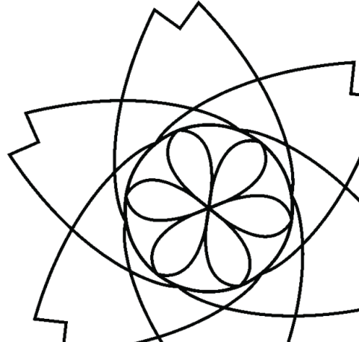

Conclusion
Humans should be ‘paropkari’ like trees.
Trees tolerate heat, rain, and disasters but they try to protect others. When with our Life, Wealth, Intelligence, and Words we try to benefit others.
This is the true definition of Success in Life.

